Slide 1
FAIR2: A framework for integrating community knowledge in data analytics and addressing discrimination bias
Centering the Public Interest in Integrated Administrative Data Analytics
Module 1 of 5
Public Interest Technology University Network Year 6 Challenge
January 2026

Slide 2
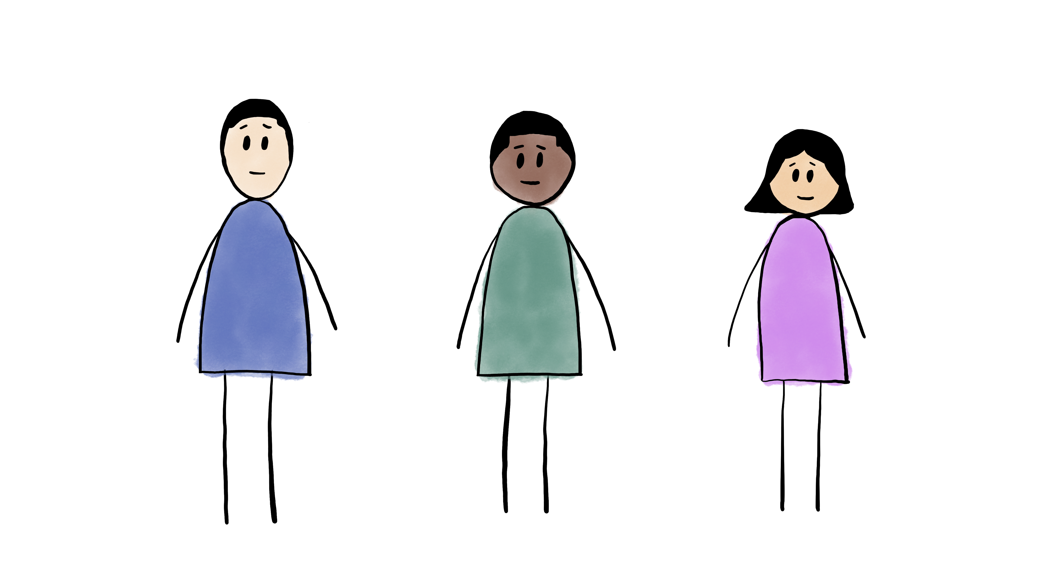
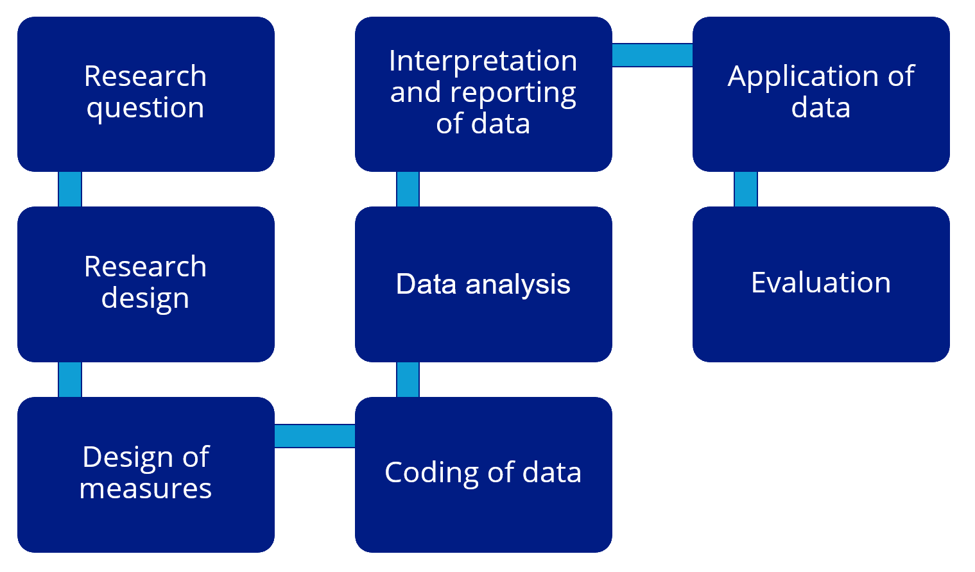


Module 3
An illustration of Label Bias in Homelessness
Data Analytics
Module 5
Recommendations to address constraints and bias in Integrated Data Analytics
2 2
Module 1
FAIR2: A framework for integrating community knowledge in data analytics and addressing discrimination bias
Module 4
An illustration of
Collider Bias in
housing research
Module 2
Demographic Data in Integrated Data Systems: Seeking Experiential Knowledge to Inform Race and Gender Data

Slide 3
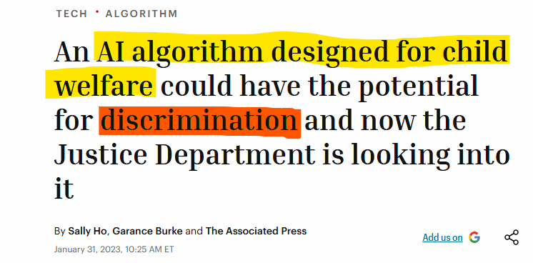
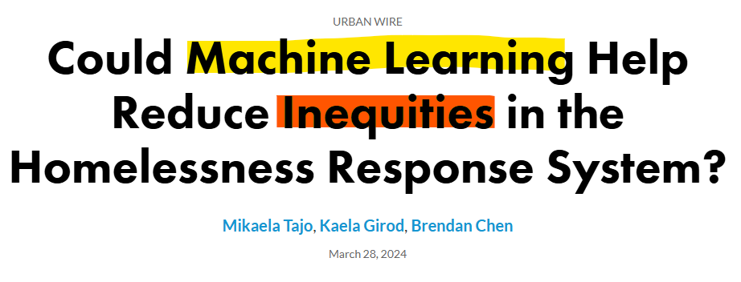
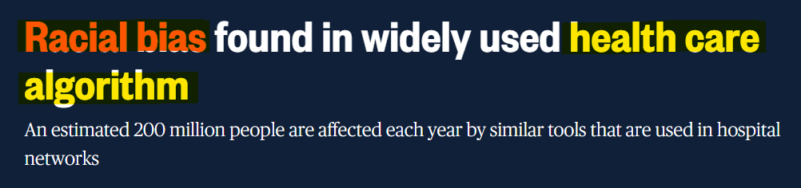
Public interest in an Era of Big Data Technologies
Decision making in health and human services is increasingly aided by data technologies.
How do we ensure that data analytics and metadata account for the experiences of those represented and avoid perpetuating bias in society?
(Tajo et al., 2024)
(Goldstein, 2023)
(Gawronski, 2019)
Notes:
“Widely used health care algorithm has racial bias”
Harvard School of Public Health, 2019
“An AI algorithm designed for child welfare could have the potential for discrimination and now the Justice Department is looking into it.” Fortune 01/31/2023
“… Could Machine Learning Help Reduce Inequities in the Homelessness Response System?”
Urban Institute Report, March 2024

Slide 4
What is FAIR2?
Ethical standards of metadata FAIRification: Findable, Accessible, Interoperable
and Reusable principles (Wilkinson et al., 2016)
When using social data for the public interest, add FAIR2 principles (Richter et al., 2023):
Frame meta(data) with contextual, experiential knowledge
Articulate assumptions into system (causal) graphs
Identify and address bias in data analytics
Report findings to community stakeholders and seek feedback.
FAIR2 is a framework for Public Interest Technology (PIT) in Data Analytics
PIT: study and application of tech expertise to advance the public interest - generate public benefits - promote the public good. https://cwru-dsci.org/

Slide 5
Why FAIR2? Predicting High-Risk Patients to Increase Health Care Support
(Obermeyer et al., 2019)
Analytics: A major health system used an algorithm to flag patients with the most complex needs to enroll them in a specialized care management program. Analysts used Total Health Care Costs as a proxy for Medical Need. They assumed that the more a person spends on healthcare, the worse their health condition
Result: at the same data-derived risk score, African American patients had more severe diabetes, kidney failure, etc., than white patients
Data most likely agreed with Standard FAIR principles: it was Findable, Accessible, Interoperable, and Reusable. So, how did bias arise? Structural inequities (lower access to care, bias in treatment), meant the system historically spent less on Black patients
Under the FAIR2 Framework, experiential knowledge of patients would have clarified that cost data are not a good reflection of health status for patients historically marginalized

Slide 6
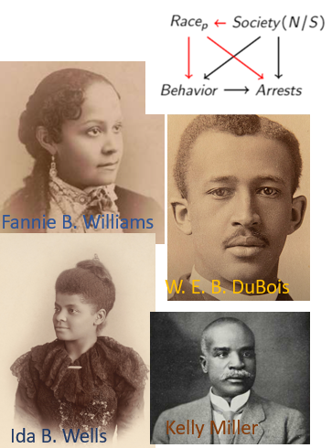
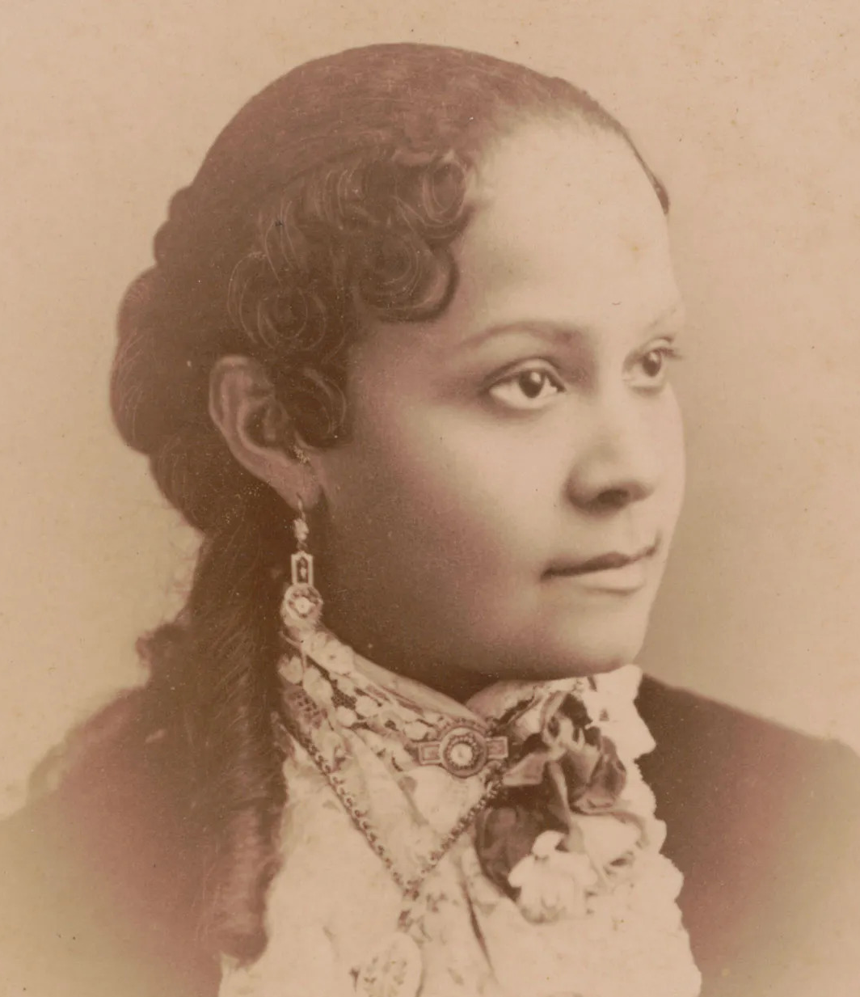
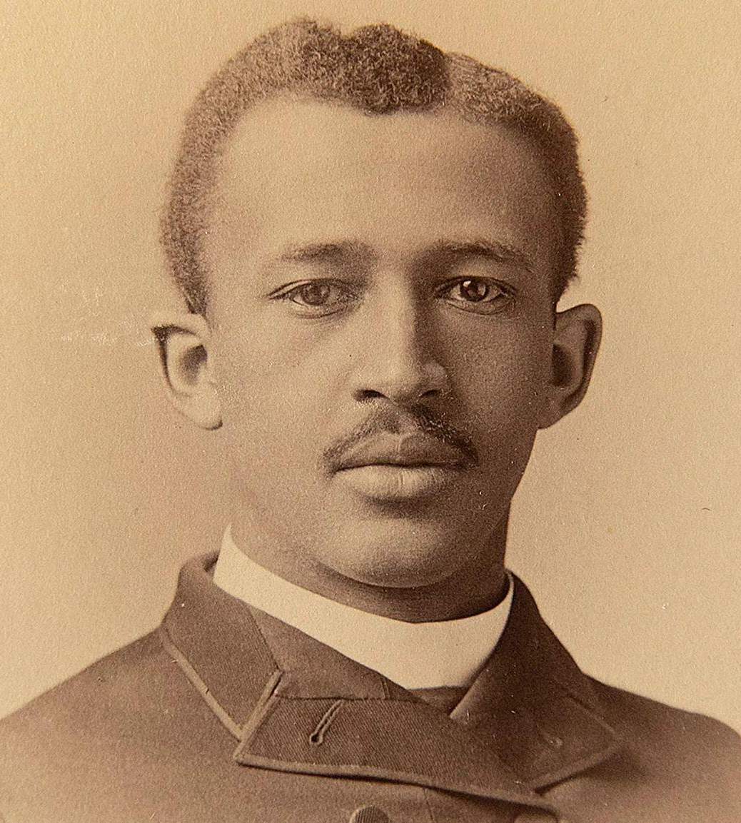
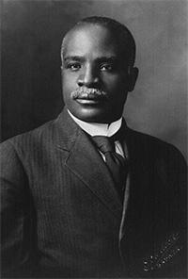
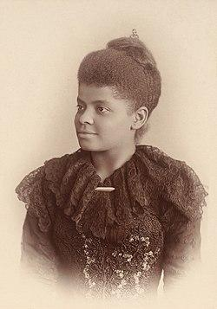
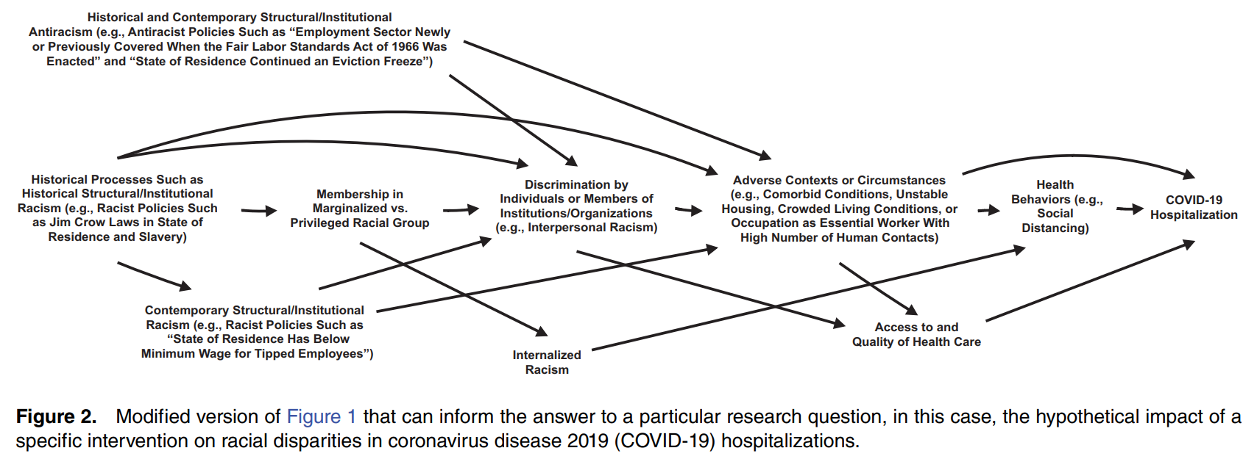
FAIR2 draws from work by scholars and activists calling for better data science now and then
Fannie B. Williams
W. E. B. Du Bois
Kelly Miller
Ida B. Wells
Muhammad, K. G. (2019), Pearl, J., & Mackenzie, D. (2018). Kleinberg et al, (2018), Howe et al., 2022.
(Howe et al., 2022)

Slide 7
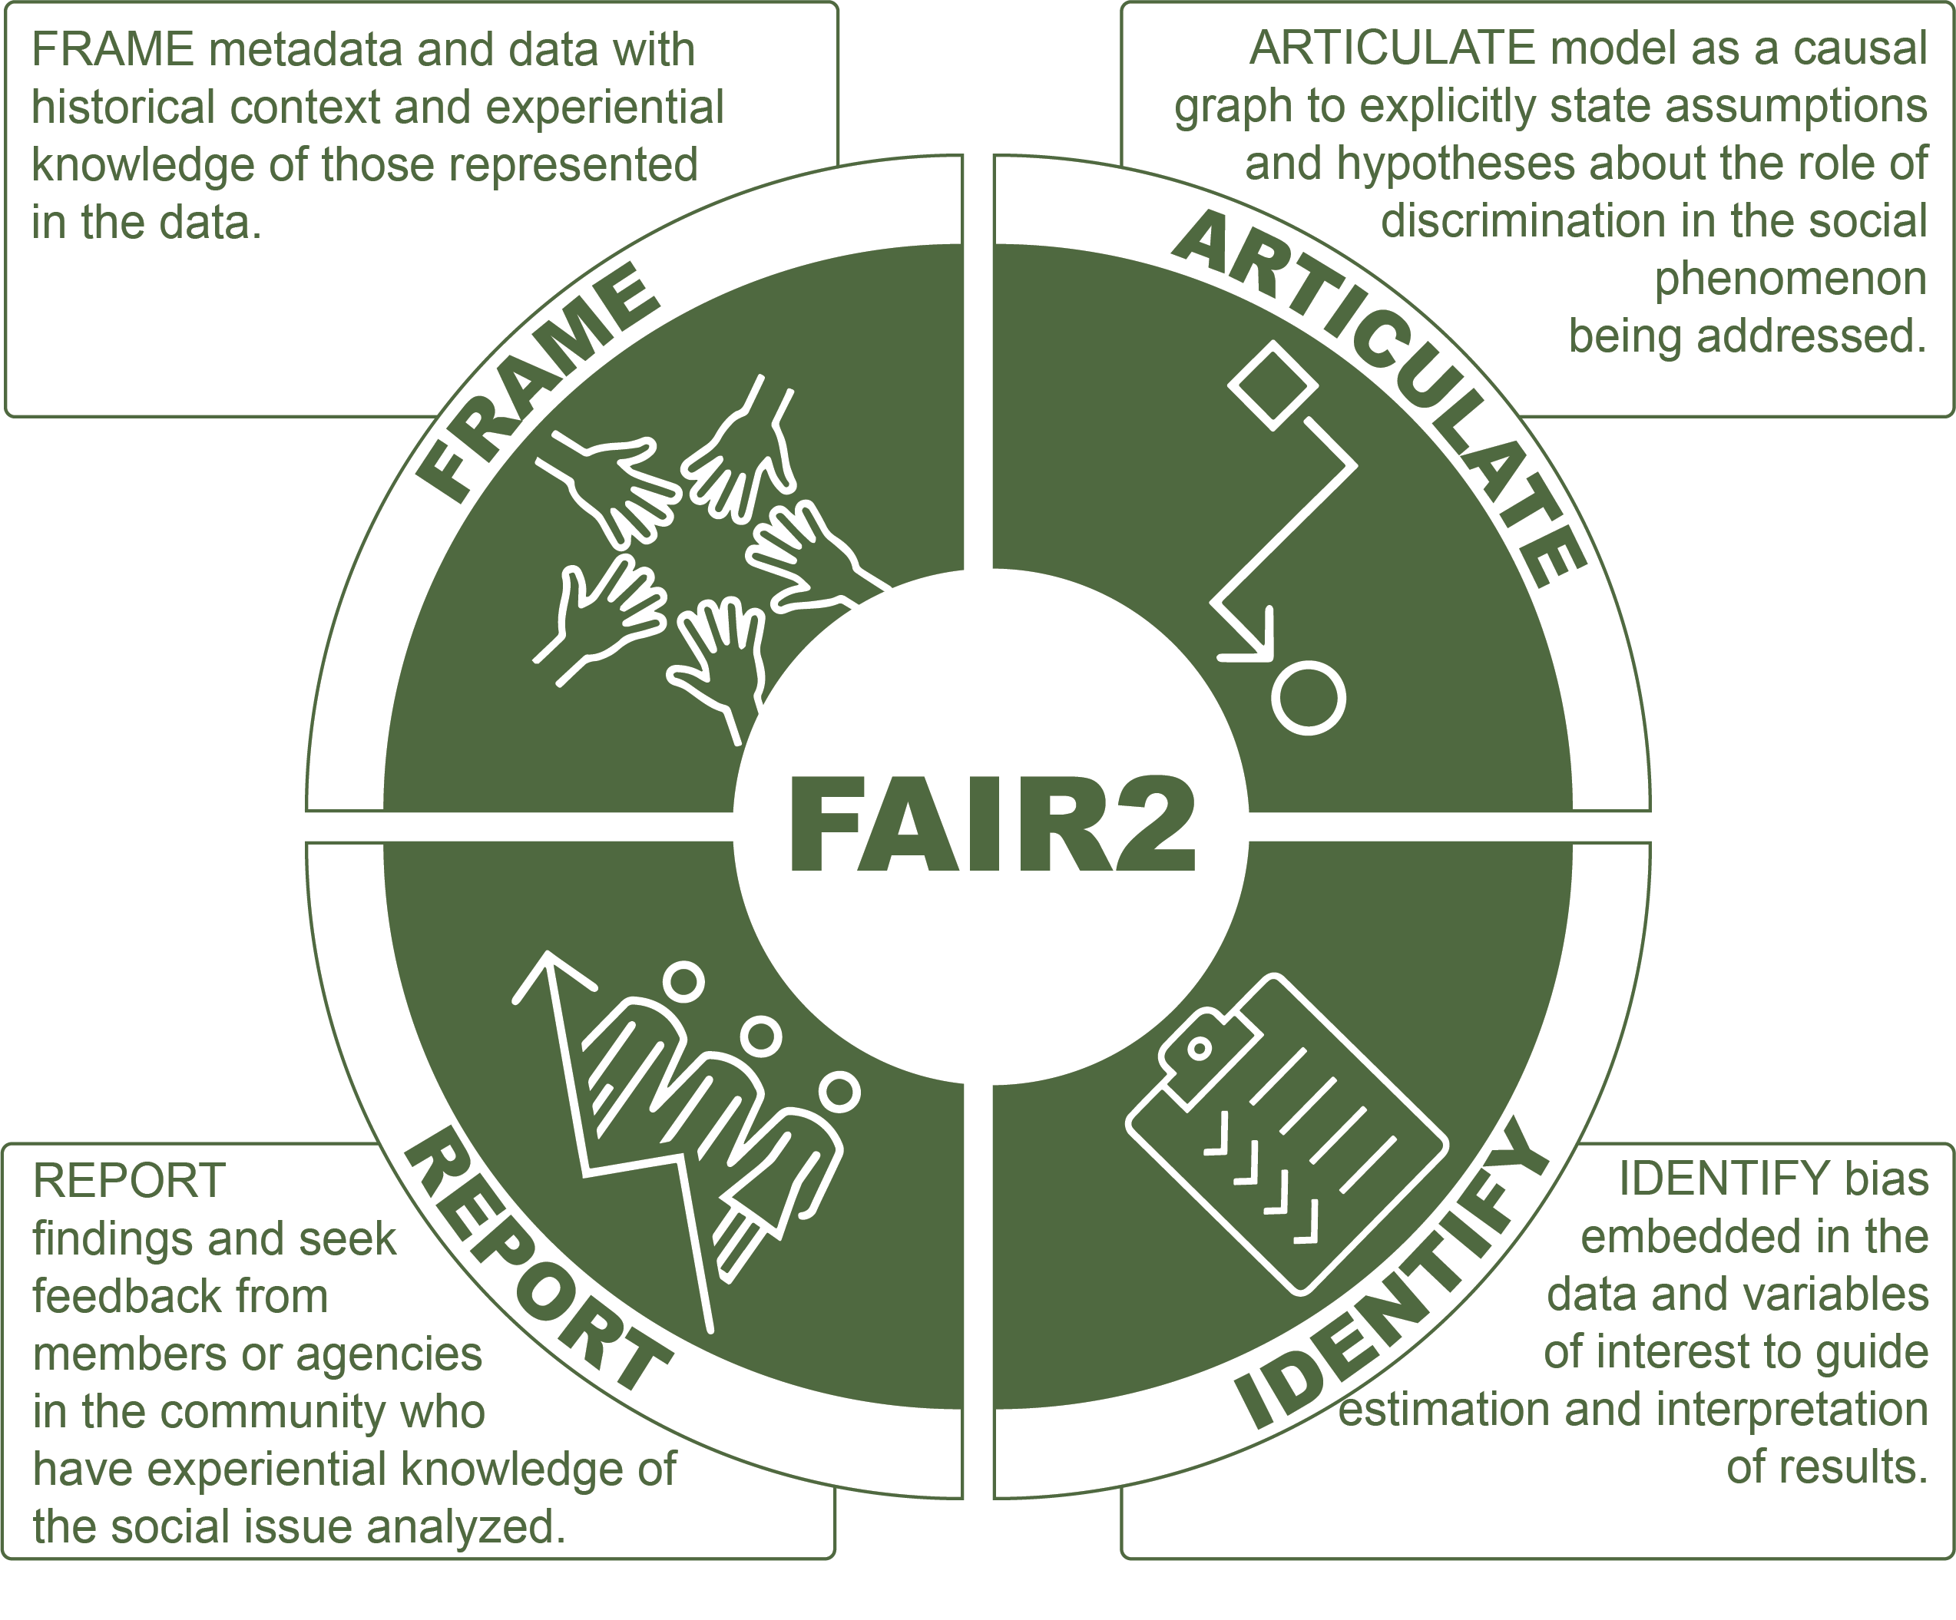
FAIR2 recognizes that data do not speak for themselves, that observational data reflect discrimination in society, and that an explicit framework to identify and address discrimination biases will further data science’s potential to advance social justice.

Slide 8
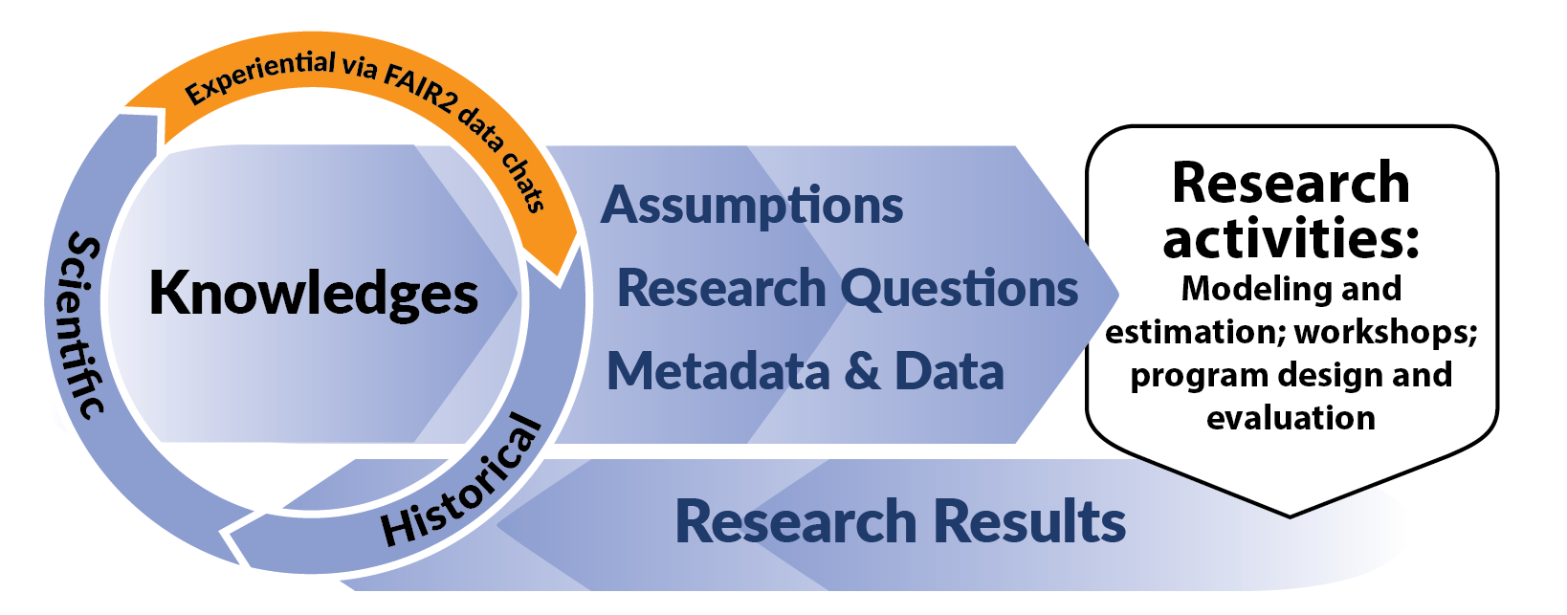
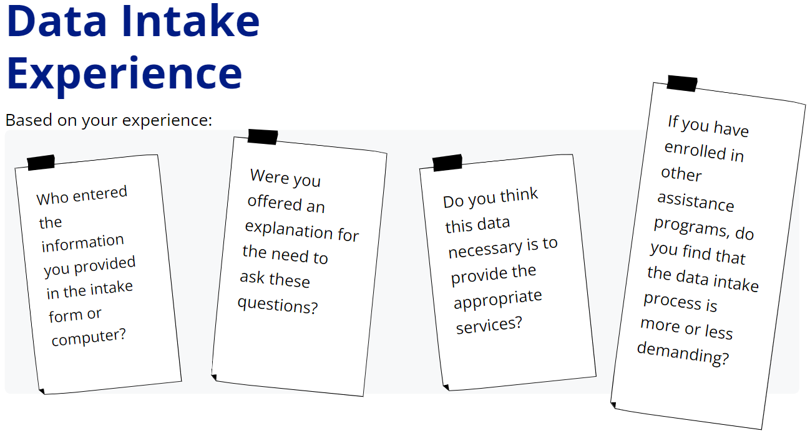
Frame metadata and data with historical context and experiential knowledge of those represented in the data: Data Chats
Data Chats are guided conversations between practitioners and people whose experiences are represented in the data
Aim is to leverage experiential knowledge to inform the inputs of the data analytic process or research activity

Slide 9
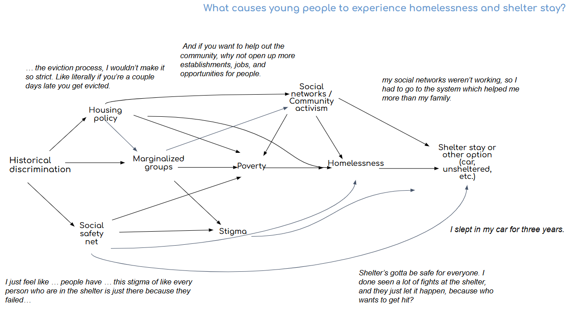
Articulate the general model as a causal graph
Use insights from Data Chats and the literature to build a causal model
A Causal Graph maps assumptions about how the process that generated the data we want to analyze
Aim is to explicitly state model assumptions (background knowledge) and hypotheses about the role of discrimination in the social phenomenon studied

Slide 10
Identify biases embedded in the data and variables of interest
What is the social goal? | Prioritize housing for those at highest risk of homelessness. Data analytics aim is to predict homelessness risk.
Choice of the Outcome | Desired Y: unsheltered at 6 months. Measured Y: seen in administrative homeless service (HMIS) records at 6 months.
 | Bias when using measured versus desired Y: if previous shelter experience was negative, folks will experience homelessness outside of the system and not appear in administrative records.
Choice of the Inputs | Desired X: experienced food insecurity in past year Measured X: enrolled in SNAP program as seen in administrative records
 | Bias when using measured versus desired X: food insecure folks that do not meet work requirements will not be in SNAP and assumed food secure.
 | Role of variable reflecting discrimination status (sex, gender, race, ethnicity)
Data | Selective Labels: if we only use HMIS records, we will fail to predict homelessness for vulnerable groups that feel unsafe in shelter.
 | Race and gender are captured in diverse ways in administrative data; how do we aggregate and report along these categories?
Approach adapted from Kleinberg et al. (2018)
Systematically scan data inputs for mismatches in desired versus measured constructs and target population
Aim is to minimize bias and report on limitations due to bias

Slide 11

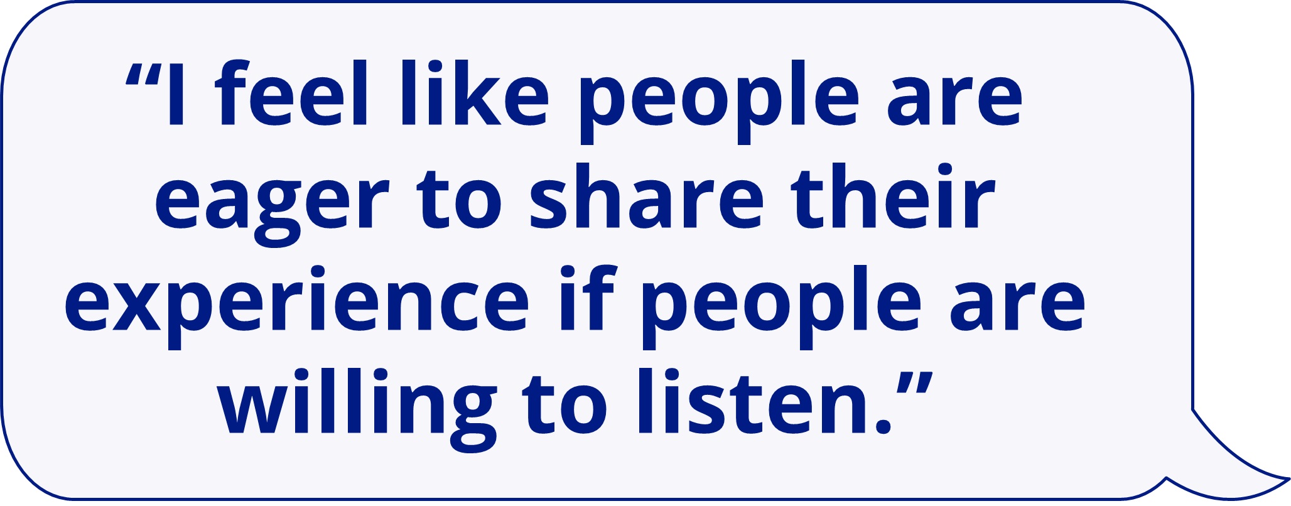
Report findings to and seek feedback from community stakeholders
Feedback from various Data Chat participants after receiving report:
I’m just so glad you all are taking your time to hear our thoughts and experiences. I feel like students using this for research should not be the final destination … We need to show this to people in charge …
“Statistics are important, but I think we should spend more time emphasizing the why versus the who.”
Report back to Data Chat participants and stakeholders
Aim is to democratize the data analytic process, seeking feedback from community members whose well-being is at stake and from agencies who work to address the social issue analyzed

Slide 12
FAIR2 is a framework for Public Interest Technology (PIT) in Data Analytics
FAIR2 Principles:
Frame meta(data) with contextual, experiential knowledge
Articulate assumptions into system (causal) graphs
Identify and address bias in data analytics
Report findings to community stakeholders and seek feedback

Slide 13
References
Gawronski, Q. (2019). Racial bias found in widely used health care algorithm. NBC News. https://www.nbcnews.com/news/nbcblk/racial-bias-found-widely-used-health-care-algorithm-n1076436
Goldstein, M. (2023). An AI algorithm designed for child welfare could have the potential for discrimination — and now the Justice Department is looking into it. Fortune. https://fortune.com/2023/01/31/ai-algorithm-child-welfare-pitsburgh-justice-department/
Howe, C. J., Bailey, Z. D., Raifman, J. R., & Jackson, J. W. (2022). Recommendations for Using Causal Diagrams to Study Racial Health Disparities. American journal of epidemiology, 191(12), 1981–1989. https://doi.org/10.1093/aje/kwac140
Kleinberg, J., Ludwig, J., Mullainathan, S., & Sunstein, C. R. (2018). Discrimination in the Age of Algorithms. Journal of Legal Analysis, 10, 113–174.
Muhammad, K. G. (2019). The Condemnation of Blackness: Race, Crime, and the Making of Modern Urban America, With a New Preface. Cambridge, MA: Harvard University Press.
Obermeyer, Z., Powers, B., Vogeli, C., & Mullainathan, S. (2019). Dissecting racial bias in an algorithm used to manage the health of populations. Science (New York, N.Y.), 366(6464), 447–453. https://doi.org/10.1126/science.aax2342
Pearl, J., & Mackenzie, D. (2018). The Book of Why: The New Science of Cause and Effect (1st ed.). USA: Basic Books, Inc.
Wilkinson, M., et al. (2016). The FAIR Guiding Principles for scientific data management and stewardship. Scientific data, 3, 160018. https://doi.org/10.1038/sdata.2016.18
Richter, F. et al. (2023). FAIR2: A framework for addressing discrimination bias in social data science. Editorial Universitat Politècnica de València. 327-335. https://doi.org/10.4995/CARMA2023.2023.16400
Robinson, W. R., Renson, A., & Naimi, A. I. (2020). Teaching yourself about structural racism will improve your machine learning. Biostatistics, 21(2), 339–344.
Tajo, M., et al. (2024). Could machine learning help reduce inequities in the homelessness response system? Urban Institute. https://www.urban.org/urban-wire/could-machine-learning-help-reduce-inequities-homelessness-response-system

